Slide 1

DR. D. Y .PATIL INSTITUTE OF ENGGINERING,MANAGEMENT& RESEARCH
DEPARTMENT OF ELECTRONICS &TELECOMMUNICATION
“PARKING ASSISTANCE ON A CROWDED ROAD USING INDUCTIVE LOOP & IOT”
Presented by: Guided by:
1.Atul Srivastava [Roll no.01] Mrs. Amruta Chore
2.Aniket Londhe [Roll no.17]
3.Govind Kumar [Roll no.10]

Slide 2
INTRODUCTION
Parking assistance on crowded road using inductive loops and IoT is gaining significant popularity in metropolitan cities.
This process eliminates all the problems related to parking in crowded roads.
It uses inductive loops which helps in detecting the vehicle.
It can also be used to classifies the types of vehicles e.g. bicycle, motor bike, car or bus.
It indicates the status of parking lots on GPRS enabled handsets of a particular area.

Slide 3
WHY THIS TOPIC IS CHOOSEN?
In the modern society, there is an ever-increasing number of vehicle, which leads to various major parking issues these days. The three main problems due to increasing number of vehicles and the inefficient parking system are:
Valuable time wasted from inconvenient and inefficient parking lots .
While driving around parking lots or from crowded roads in search of available and accurate space, leads to wastage of fuels and more CO2 emissions takes place.
Potential accidents are caused by abundance of moving vehicles in disorganized manner in parking lots .
Therefore in order to eliminate these problems in our day to day life there is a need to develop an efficient parking system which will effectively eradicate such problems.

Slide 4
LITERATURE SURVEY
Till date, there are three types of the vehicle detecting systems:
1.) Overhead level detector
A surveillance video camera
IR sensors
2.) Ground level detector
Pneumatic sensor
3.) Underground level detectors
Underground Inductive Loops
In previous detection systems data loggers were used in order to store the information and were restricted for the remote drivers. Therefore in order to send the current status of parking areas we came up with the idea of IOT.

Slide 5
AIM & OBJECTIVE
To find parking space in crowded area within short period of time.
Accurately predicts and senses vehicle occupancy in real time.
Guides residents and visitors to available parking.
Simplifies the parking experience and adds value for parking stakeholders, such as drivers and merchants.
Enables intelligent decisions using data, including real–time status applications and historical analytics reports.
In 21st century we want to hyper connected society in which objects are connected to mobile devices.

Slide 6
BLOCK DIAGRAM
Inductive Loop
Power Supply
LC Oscillator
Pulse Shaping
ATmega8
CC2500 RF Module
Block Diagram of Parking Loop

Slide 7
BLOCK DIAGRAM
GATEWAY:
LC OSCILLATOR : The electronic circuit consist of inductor and capacitor which can act as a resonator. It is used either for generating a signal at a particular frequency or picking out a signal at a particular frequency.
PULSE SHAPING: It is process of changing the shape of transmitted pulse for better understanding.
CC2500 RF MODULE: It is a transceiver used for very low power wireless application. It can be controlled by SPI interface.
ATMEGA8 and ATMEGA16: It is a low-power CMOS 8-bit microcontroller which executes powerful instruction in a single clock cycle with high processing speed.
GPRS/GSM MODULE: This module is used to establish communication between a computer and a GSM-GPRS system.
CC2500 RF Module
ATmega16
GPRS/GSM Module

Slide 8
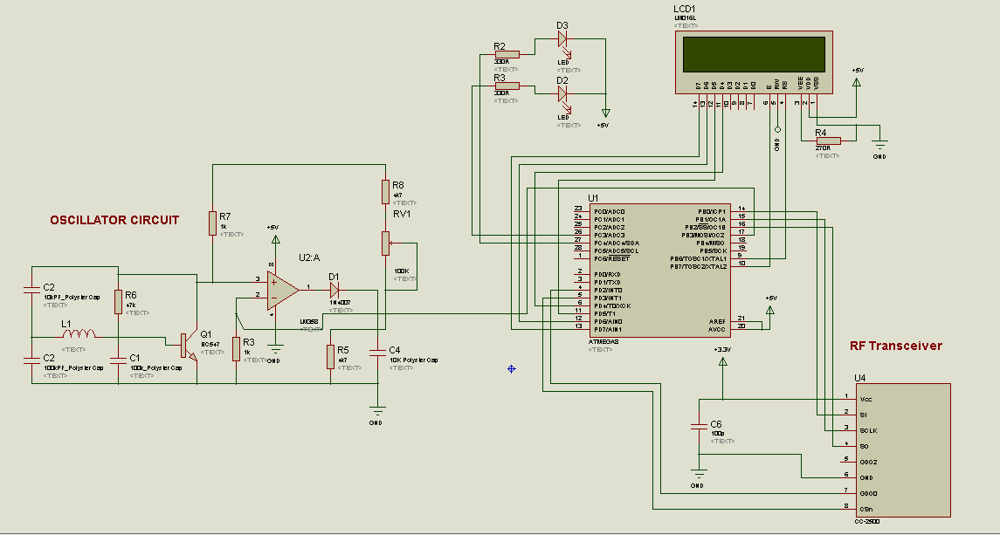
Circuit diagram
Parking loop system

Slide 9
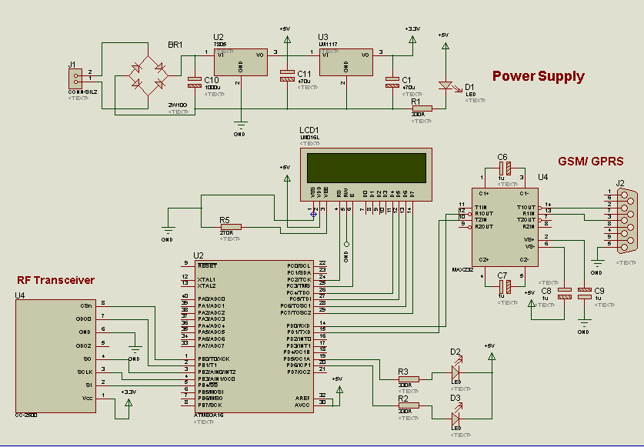
circuit diagram
Gateway system

Slide 10
FLOW CHART of parking loop
START
Initialize LCD, Timer, SPI & RF
Load Set Point from EEPROM
Read Pulse
Set Point > f
Vacant Space
NO
YES
Space Occupied
RF Transmission
STOP

Slide 11
FLOW CHART OF GATEWAY
START
Initialize LCD,UART,GSM,SPI & RF
Connect to GPRS
Connected?
NO
YES
Read Data
Upload data to server
Uploaded?
NO
YES

Slide 12
HARDWARE AND SOFTWARE TOOLS
Hardware specification
Microcontroller: Atmega8 and Atmega16
RF module: CC2500
GPRS/GSM module
Inductive Loop
Pulse Shaping Schmitt trigger
LC oscillator
Diodes: 1N4007
Transformer: 15V, 1A
LCD : 16*2
Voltage regulator: LM7805
Software specification
Express PCB
Proteus
AVR Studio

Slide 13
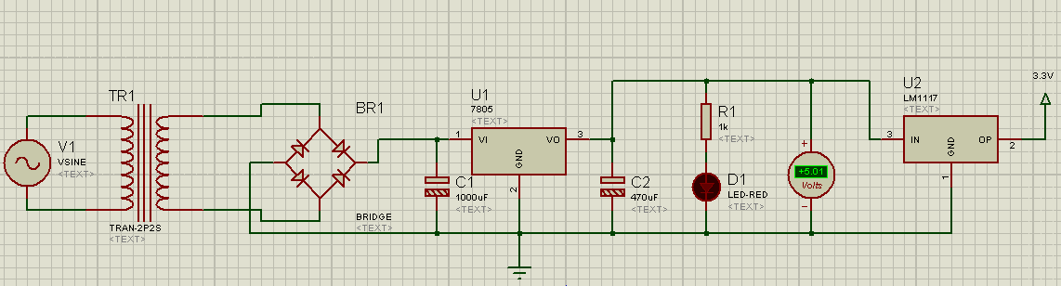
EXPERIMENTAL RESULTS
Power Supply Simulation

Slide 14
ADVANTAGES AND DISADVANTAGES
ADVANTAGES :
Helps in saving fuel.
Optimized Parking Space Usage.
Help traffic in the city flow more freely leveraging IoT technology
Collison and accident protection technique.
Saves enormous time of an individual.
DISADVANTAGES :
Since the application is at its initial stage. It s limited to a particular area only.
We have to introduce separate inductive loops for each parking spot which will make this system costly.

Slide 15
APPLICATIONS
Parking assistance on crowded roads.
It can be used in controlling traffic on busy routes.
It can be used in lane control in highways to avoid accidents.
Used for vehicle identification.
Vacant and occupied slots can be seen on smart phones using GPRS and Iot.

Slide 16
FUTURE SCOPE
To detect each parking spot for a vehicle in a multi-storing parking is not possible but if we modify this and specify each floor parking space then this application would be more efficient.
If we make an application that will take this type of format in a large scale/large area for example: city , 2 or 3 towns etc. Then this will help in large scale.
Can be implemented with 2-way communication system in order to book a particular parking spot by GPRS enabled handsets.

Slide 17
REFERENCE
[1] S. Sheik Mohammed Ali, Boby George and Lelitha Vanajakshi “A Multiple Loop Vehicle detection System for Heterogeneous and Lane-less Traffic” Indian Institute of Technology Madras, Chennai, India.
2] Mr. Basavaraju S R “Automatic Smart Parking System using Internet of Things (IOT)” Department of Information Science and Engineering, RV College of engineering Bangalore, Karnataka, India.
[3] C. Minsen , J. Ngarmnil and T. Rongviriyapanich “Embedded adaptive algorithm for multi-lanes-traffic inductive loop detecting system”. Electronic Engineering Department, Mahanakorn University of Technology, Thailand.
[4] Rakesh V.S1, Shaithya.V2 “A Traffic Control System Using Inductive
Loop Detector” Assistant Professor, Dept. of ECE, Vidya Academy of Science and Technology, Thrissur, Kerala, India1 , PG Student [Embedded Systems], Dept. of ECE, Vidya Academy of Science and Technology, Thrissur, Kerala, India2.
[5] Deep Desai and Sunil Somani “Instinctive Traffic Control and Vehicle Detection Techniques” Department of E&TC, MITCOE Pune, India.

